Slide 1




Exabeam
Capture the Flag
Hunter Games
26th March 2021
Harjith – Technical Alliance Director
Notes:
Thanks for joining everyone! We’ve got a fun event ahead. Let’s start off with some logistics to ensure everyone is ready to play. Please try not to skip ahead here – logging in is probably the most difficult task of the day!
________________________
If you plan on having prizes, this is a good time to announce those as well. Some examples from previous events below, feel free to get creative.
Prize winning formats:
1. Winning team and highest individual scorer win a prize – have seen this restricted to highest scorers -outside- of winning team if it’s the same prize.
2. Winning team wins a prize
Prize examples – please work with your team for these:
$100 Amazon giftcards for each member of winning team
Oculus rift for highest scorer, gift card for each member of winning team
Exabeam swag (clothing, branded gear, etc)
Some events have also provide all of the attendees something to enjoy the event with:
1. Whiskey/wine/cocktail kits
2. Wings
3. Doordash giftcards to enjoy a meal while playing
(Slide note: Logo needs updating, branding needs updating).

Slide 2
What?
A Capture the Flag challenge for security teams
Participants will compete head-to-head on security challenges using Exabeam Advanced Analytics and Threat Hunter modules.
A virtual (in-person one day) event with duration of ~120 min
Exabeam
Capture the Flag
Why?
What participants can achieve from Capture the Flag?
Get familiarized with Exabeam Advanced Analytics features.
Learn Threat Hunting and Investigations using
Exabeam Advanced Analytics.
Explore advanced features like Data and Behavioral Modeling
To summarize, participants will explore and get familiarized with Exabeam Advanced Analytics features in a fun-filled way!

Slide 3



The Exabeam Difference
Automate Triage and Investigation
Gain Visibility into Insider Threats and Compromised Credentials
Augment Legacy Security Tools
Automate the whole SOC workflow, not just detection and response
Identify attackers even when they mimic legit user activity
Modernize your SOC by building on your existing SIEM investment
Notes:
// Feel free to skip this slide, but it’s nice to have some kind of introduction to what we do for many events. //
With Exabeam, Security teams are able to automate triage and investigation, gain visibility into insider threats and compromised credentials, and augment legacy security tools.
When most people think automation, they think SOAR. The rest of what they are doing in the SOC is mostly manual. SOAR is the last mile of the journy though. You can only automate what you can detect today.
We can gain visibility into the way creds are used in the environment. Whether it’s an insider trying to do bad things, or an outsider trying to get in, all roads lead to credentials. Attackers covet these.
If a customer just renewed a legacy product or stuck in a long term renewal, we can add a lot of value on top of that – it’s kind of our bread and butter. We’re the only vendor in the MQ thatI know of that can augment other solutions
_____________________________________
CUSTOMER EXAMPLES
​
Reduce Infrastructure Costs:​
Levi’s Strauss & Co. — Levi’s was looking to implement a new SIEM that would provide them better visibility in their environment. However, new visibility meant bringing in many new log sources, which would drive up logging costs since their legacy SIEM was licensed using a volume based pricing model. They decided to implement the entire Exabeam platform with user-based licensing. As a result, they were able to ingest more data sources and improve the visibility in their environment by 5x while also cutting costs compared to their previous solution. Amongst other benefits, Exabeam search queries ran 13x faster, improving SIEM performance. ​
Case study available here: https://pages.exabeam.com/rs/432-FPK-252/images/EXA_Case-Study_Levis_10_14.pdf​
​
Find Advanced Threats: ​
Safeway – POS Malware Detection
Safeway had two networks which were supposed to be fully separated: a corporate network and a retail Point of Sale (POS) network. When they deployed Exabeam they discovered that an HR employee had been accessing over 1,700 Point of Sales systems within the retail network. This was a big problem because those machines had highly sensitive customer data.
Safeway had been using Active directory and 2 factor authentication to limit access to the POS network. They also had correlation rules in place such that failed log-ins would generate an alert to clue security teams in that someone as attempting to access this network. The problem came from the fact that there was nothing in place to track if the wrong users had successfully logged into the retail network. Exabeam was able to detect this problem because we do NOT use rules for detection, we use behavioral modeling. It was anomalous at Safeway for someone in HR to be accessing the retail network.
By implementing Exabeam, Safeway was able to detect this threat and discover:
Their 2FA had was misconfigured and wasn’t doing its job.
The user involved had been infected with malware
​
Analyst Productivity: ​
ADP — Situational awareness
Before implementing Exabeam, performing investigations to truly understand what happened with any specific security alert, could take the ADP team more than a week. This investigation took more than a week because the process of understanding the scope of an attack (e.g. determining the involved users, work stations, network segments, files, etc.), and establishing the incident timeline and sequence of activities—required teams to gather a huge amount of evidence and assemble it into a timeline by querying and pivoting in their SIEM.
With Exabeam, ADP was able to take any artifact from any alert or security tool—for example a user name, IP address, alert ID, or host name—and input it into the Exabeam search bar to instantly obtain a machine-built incident timeline including that item. These machine-built timelines show the surrounding context around that artifact or alert, include what happened, in what order, whether it was normal or not, and what happened before and after it. ADP refers to this capability as situational awareness; it enables their team to rapidly investigate threats with a friendly, easy to use interface—almost like an “always on threat hunting.”
Video testimonial here: https://www.youtube.com/watch?v=7hOBdFQQ59U

Slide 4
Exabeam gives instant context to Compromised Insider Attacks
Exabeam notifies SOC analyst 1 hr into attack using only out of the box models
EDR alert to Powershell and Mimikatz on server
May 7, 21:15
Time into attack: 5hr. and 12 min
May 7, 22:15
May 8, 2:20
May 8, 2:27
May 8, 2:27 – 8:56
Initial access: First login from Singapore for user and org
First activity from ISP for user
First OS/browser combination in user agent string
Lateral movement:
# of first access to asset for user: 272
Lateral movement:
Attacker pivots off initial host to ServerX
First RDP activity for user
First access to ServerX
Lateral movement & privilege escalation:
# of first access to assets by user: 487
# of first communication between assets : 487
# of first credential switches from host: 233
Risk score: +30
Risk score: +10
Risk score: +60
Risk score: +30
Where did they go in the environment?
What assets did the user access?
What was the initial user access – location, OS, browser?
Did the attacker escalate privileges or switch credentials?
What did Exabeam detect
Outcomes enabled by Exabeam
Comprehensive and complete picture of the attack
Details of abnormal user behavior and Lateral Movement
Compromised Credentials connecting on the VPN from Singapore
Assets affected: 759
Number of credentials switched: 234
notepad.exe running out of an abnormal directory C:\\PerfLogs\
Detailed timeline of activities and assets
Remediation of the entire threat
Led to resetting all 234 credentials
Informed the need to preform AV scans of all assets involved
Helped review all users as assets to identify abnormal activities
Insights helped decision to clean up ServerX
Notes:
// Feel free to skip this slide, I like to use it as a reminder that what they are looking at in timelines is automated, and filling in a ton of information other tools aren’t providing.//
I want to show you how Exabeam not only automates the detection and investigation, but also answers the questions analysts generally have when they see an alert. The red bit at the top of the screen is an EDR alert, and an alert like this is where many analysts start their investigations. They need to figure out what happened before, during, and after this alert firing.
And in this real world scenario, we are using only 3 log sources, yes, only 3 log sources; and this is not a customized deployment, it’s prebuilt; without any custom rules.
Again, none of these questions about the attack are answered by a single alert
(click)
What was the initial user access – location, OS, browser?
(click)
1st we see initial access coming in from Singapore (1st time for the user and for the org).
(click)
Where did they go in the environment? What assets did the user access?
(click)
Well, an hour later we see what appears to be lateral movement where the user accesses multiple assets for the first time.
A few hours later (in the green text) we generate our first notable user. At this point the customer knows nothing; they only know what Exabeam is telling them - there's some weird behavior.
Next we see more lateral movement where the attacker pivots from the initial host and uses RDP to move to ServerX.
(click)
AND Several HOURS from when Exabeam started tracking this attack, the first natural alert fires from Crowdstrike, which by the way, is a critical piece to helping us connect these dots.
(click)
Did the attacker escalate privileges or switch credentials?
(click)
After that EDR alert we continue tracking and see 487 assets accessed using 233 different credentials.
(click)
So let’s wrap up this timeline. What did Exabeam detect? (read a few from slide)
(click)
What outcomes did Exabeam enable?
(Remediation of the entire threat,etc from slide)
To dig deeper into EDR and standard incident response at most companies:
So, let me ask you this...what would they have seen without Exabeam? And what would they have done with the Crowdstrike alert?
Most would answer that they would have seen the CS alert and likely rebuilt that server and gone about their day.
Don't get caught up in when CS fired...it did what it was supposed to do. The story is not that CS missed something, the story is that Exabeam, with 3 log sources, automated the entire investigation. This doesn’t come from any other product or platform in the industry.
Oh, and by the way…This customer had over 20 anomaly detection security products and only one product saw anything and that’s the red bit on this screen. If this attack happens to customers today and they don’t have Exabeam, all they will see is the red piece.
Optional:
Now, if they’ve got Splunk they can send guys to query to start to put this puzzle together, but how long will that take? Will they find it all? Would a human beat a machine in the ability to stitch together the points? Who wins?
Optional:
For those of you who have been paying attention to the recent Solarwinds breach, about 80% of what we are showing you in this actual breach is a direct match for the behavior you’d want to look for in defending against the Solarwinds breach. For instance, when you see them dumping 233 creds, that’s a match for the SW playbook. But look, this isn’t something we added post SW breach…this is foundational to how we started Exabeam.

Slide 5
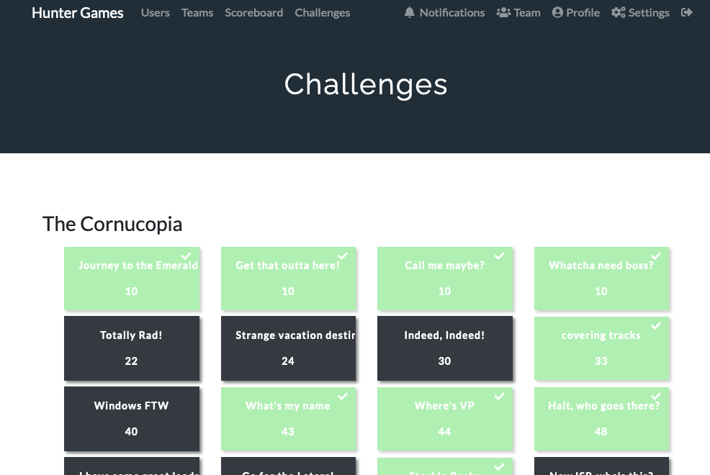
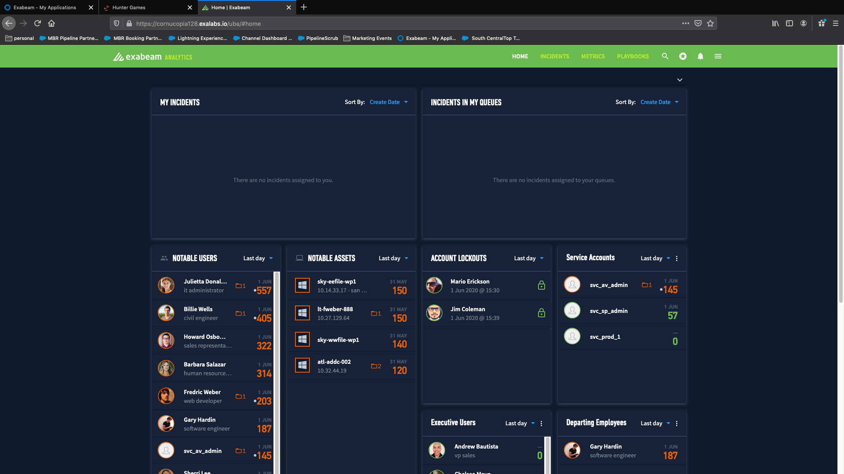
Player Instructions
Open the Hunter Game UI: https://ctf-0-event.exalabs.io
Register > Pick Your Username (Make It Fun…But Clean) ☺
Join Team > Login Info Provided
Quick Demo on Advanced
Sign-In to the Advanced Analytics Environment
Teams will be sent to breakout rooms to play the game!
Please Note: You will be working from both UI’s shown here:
Notes:
//Confirm URLs provided before event and update this slide. I find showing this slide, and then bringing up the UI to guide them helps. Walk users through opening CTF UI and registering.//
https://ctf-0-event.exalabs.io/ (Most commonly used, 35 max)
https://exp-0-event.exalabs.io/ (Large instance, ~50. We have not stress tested this, max of 38 so far)
https://exp-1-event.exalabs.io/ (Rarely used)
(AA+DL UI’s linked at bottom of main CTF screen)
CTF UI: admin | 5waOq7xC99QT
Exabeam UI: soc-manager | sub38Dee61map$!
Answer bank (other than CTF admin UI)
AnswerBank_Master_CTF
"District 1" through "District 9". Passwords to join the team are "District@1" through "District@9". Example on next slide.

Slide 6
Team Assignments
Team 1 (District 1 | District@1) | Team 2 (District 2 | District@2) | Team 3 (District 3 | District@3)
Team 4 (District 4 | District@4) | Team 5 (District 5 | District@5) | Team 6 (District 6 | District@6)
Notes:
Team logins are on this screen.
-You can simply take a picture of breakouts in Zoom and post on the right side if you need to do this on the fly.

Slide 7
Team Assignments
Team 1 (District 1 | District@1) | Team 2 (District 2 | District@2) | Team 3 (District 3 | District@3)
Team 4 (District 4 | District@4) | Team 5 (District 5 | District@5) | Team 6 (District 6 | District@6)
Notes:
Example format for teams made ahead of time

Slide 8
Player Instructions
Open the Hunter Game UI: https://ctf-0-event.exalabs.io
Register > Pick Your Username (Make It Fun…But Clean) ☺
Join Team > Login Info Provided
Quick Demo on Advanced Analytics
Sign-In to the Advanced Analytics Environment
Teams will be sent to breakout rooms to play the game!
Please Note: You will be working from both UI’s shown here:
Notes:
Welcome everyone to Exabeam Expedition!
We've got a fun game ahead of us, and I wanted to give a quick tour of the UI for anyone that is not familiar with how to use Exabeam.
AA Advanced Analytics UI.
Timeline/User Page. Show context, Risk Trend, Timeline.
Advanced Analytics automates triage and investigation by building out a timeline showing both normal and anomalous events. There are 4 main workflows that you’ll likely use to search for answers today.
Workflow 1 - Watchlist to User/Asset to Timeline (Or Watchlist to Timeline, both shown here)
*Click an asset/user page*
-Clicking on the picture brings you to the asset/user page that shows context at the top (show examples, maybe explain peer groups).
-Scrolling down will bring you to the asset/user risk trend that allows you to see the risk score trending over time. You can pull it out to a month to get a good idea for their general score. Each dot is what we call a session, and generally one session is one day. While hovering over the sessions, I can see things like how many alerts fired, or how many assets/network zones were touched. Clicking on a session updates the Risk Reasons below.
-Risk Reasons by default shows the highest to lowest score, but it’s a great way to great quick insight into an anomalous user. (show that they can expand events)
-To really get an idea of what happened with both normal and anomalous events in chronological order, let’s click on “Go to Timeline”.
*Click ”Go to Timeline*
To save you some clicks, I’ll show you a quicker way to get to a timeline. (Click back to main AA screen, then show that clicking on a risk score goes directly to that risky day’s timeline).
-On the left side if this page you can see what we call events. These are logs that have come through Advanced Analytics, and you can expand them to see what has been parsed out. On the right side, if you see a number and text, it means the event was anomalous and we applied risk. You can expand these events to see descriptions around why it was risky, MITRE mapping (rule tags), and a look into what the rule fires on. You can also click on the hyperlinks to view the histogram of the model – great for quick insights. Some hyperlinks for things like an asset or username will bring up some quick details on that asset/user.
Workflow 2 – Data Insights
-Another useful (and just cool) way to search for data is our Data Insights – it actually follows you on any asset/user page or their respective timelines. This is how you can view all of the models we currently have active for that asset/user. (Scroll through the categories).
-Maybe you want to look at things differently and see one specific model for all of the users/assets. For that, you can simply click to what I’ll call global Data insights. (Hamburger menu top right, Data Insights). Here we can use typeahead to look for a model for the entire organization. (I like to use type VPN and scroll to TOP_VPN_COUNTRIES).
Workflow 3 – Basic Search (Magnifying glass) > User/asset/IP > User/asset page (or timeline)
The next workflow is using our basic search. This allows you to quickly search for users, assets, Ips and some other categories. You will definitely be using this today, but just so you are aware, in this system, this search will only show the basic context for a user or asset. It will not allow you to get to the timeline. (show example). This is solely due to the way this system is architected. If you want to view a users' risk trend, risk reasons, or timeline, be sure to click from the main dashboards.
Workflow 4 - Threat Hunter > User/asset page or timeline
Threat Hunter is a powerful search engine that allows you to search Advanced Analytics for various items, such as users, assets, alerts, behavioral models (reasons), and MITRE techniques (rule tags).
-Features type-ahead for ease of use, simply type in a keyword and look through for something that fits the question. Make sure you are reading the question closely! There are plenty of models that wont match.
Here's a quick tour of Threat Hunter.
*Show USB models, activity types, MITRE etc. Reasons is the most important here*
For example, if I wanted to find a non-executive user that has logged into an executive asset after logging in from a Chinese VPN, I can simply select:
Activity type: VPN. Geo location: China, Reason: non-executive user logon to executive asset
Tips:
Start broad and narrow your results. Try multiple models and ensure it matches the question.
Find a team strategy. Do you want to work together on the same questions, or split them up? Maybe assign a column to each teammate. Maybe some can start with the use case questions while others go for the main AA chunk.
Try not to spend too much time on a single question - you can always come back if time allows it. Feel free to reach out to our team for assistance or if you have any questions. Questions have hints if needed.

Slide 9
Player Instructions
Open the Hunter Game UI:
Register > Pick Your Username (Make It Fun…But Clean) ☺
Join Team > Login Info Provided
Quick Demo on Advanced Analytics
Sign-In to the Advanced Analytics Environment
Teams will be sent to breakout rooms to play the game!
Please Note: You will be working from both UI’s shown here:
Notes:
https://exp-0-event.exalabs.io/
https://exp-1-event.exalabs.io/
https://ctf-0-event.exalabs.io/
(AA+DL UI’s linked at bottom of main CTF screen)
CTF UI: admin | 5waOq7xC99QT
Exabeam UI: soc-manager | sub38Dee61map$!
Answer bank (other than CTF admin UI)
AnswerBank_Master_CTF
"District 1" through "District 9". Passwords to join the team are "District@1" through "District@9". Example on next slide.

Slide 10
Tips & Tricks For Playing
Read the question VERY carefully. Look for keywords for the model and context of model.
Anything that is a directory needs to be typed out not cut-and-paste
Make sure you use the main dashboard to search for user and asset data
Work as a team – for the best score you should divide and conquer different questions. Communication amongst is the key to success!
If using Data Lake, set the timeframe to the last 2 years.
Treat the systems as read-only – do not save any changes
Use a strategy to work through questions as fast as possible – different questions have different point values! Higher value questions are at the bottom.

Slide 11

Tips & Tricks For Playing
Read the question VERY carefully. Look for keywords for the model and context of model.
Anything that is a directory needs to be typed out not cut-and-paste
Make sure you use the main dashboard to search for user and asset data
Work as a team – for the best score you should divide and conquer different questions. Communication amongst is the key to success!
Winning Team Members each receive:

Slide 12
NEED HELP WHILE PLAYING?
ASK AN EXABEAMER!
We Will Be Cycling Into Break Rooms or Will be Playing With You!
”Ask for Help” button on Zoom
Return to the Main Room
Leave > Leave Breakout Room
Notes:
Good luck. Here are a few ways to ask for help if you get stuck.
//At this point, provide Exabeam UI logins and then open the breakout rooms. Check in on all of the rooms to ensure everyone is logged in and has an idea of how to play. This might be a good time to point out the use case questions at the bottom.
_________________
Ask for Help button in Zoom only shows when you use breakout rooms
How to enable Zoom breakout rooms: https://support.zoom.us/hc/en-us/articles/206476093-Enabling-breakout-rooms

Slide 13
Internal
Notes:
Use this event as a way to teach users how to use AA/DL. Guide them through questions if needed, and keep it interactive/fun!

